Slide 1
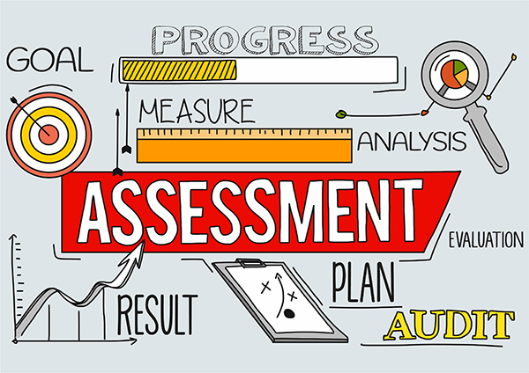
assessment
A test is an educational assessment.
A test may be administered verbally, on paper, on a computer, or in a predetermined area that requires a test taker to demonstrate or perform a set of skills.
output: A test is an educational assessment.
A test may be administered verbally, on paper, on a computer, or in a

